Slide 1
Nazifa Alam Nowrin Id. 193002103 Department of CSE CSE-201 Presentation on Internet-of-things- (IOT)

Slide 2
Plan of Presentation
What is IoT?
How IoT Works?
The Structure of IoT
Current Status & Future Prospect of IoT
Few Applications of IoT
TECHNOLOGICAL CHALLENGES OF IoT
References

Slide 3
What is IoT?
The Internet of Things (IoT) is the network of physical objects or "things" embedded with electronics, software, sensors, and network connectivity, which enables these objects to collect and exchange data.

Slide 4
How IoT Works?
Addressability
Identification
Sensing
Actuation Embedded information processing
Localization
User interfaces

Slide 5
The Structure of IoT
Tagging Things
Feeling Things
Shrinking Things

Slide 6
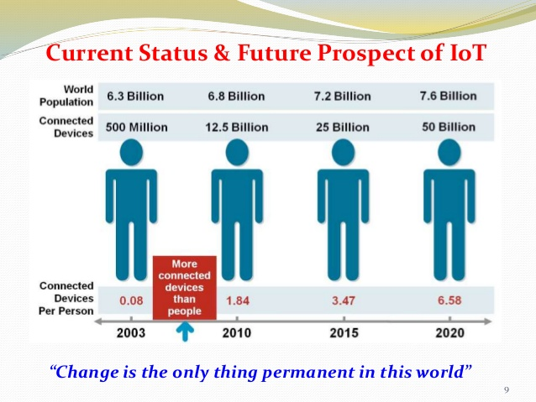

Slide 7
Few Applications of IoT
Building and Home automation
Manufacturing
Medical and Healthcare systems
Media
Environmental monitoring
Infrastructure management
Energy management
Transportation
Better quality of life for elderly

Slide 8
TECHNOLOGICAL CHALLENGES OF IoT
At present IoT is faced with many challenges, such as:
Scalability
Technological Standardization
Inter operability
Discovery
Software complexity
Data volumes and interpretation
Power Supply
Interaction and short range communication
Wireless communication
Fault tolerance

Slide 9
References
1. www.google.com
2. https://en.wikipedia.org/wiki/Internet_of_Things
3. Cisco whitepaper, "The Internet of Things" - How the Next Evolution of the Internet Is Changing Everything, by Dave Evans, April 2011.
4. GE cloud expo 2014, "Industrial Internet as a Service", by Shyam Varan Nath, Principal Architect.
5. Dr. Mazlan Abbas, MIMOS Berhad, Wisma IEM, Petaling Jaya

Slide 10
THANK YOU

